Slide 1
BIKE SHARE DATA ANALYSIS
Quansah Abaidoo meshach

Slide 2
INTRODUCTION
Hello And Welcome. In Today’s Presentation, I Am Excited To Take You Through This Bike Share Dataset.
I Am Really Excited To Be Doing This Presentation As It Has Given Me The Opportunity To Dive Into, And Gain Insightful Information About This Special Project

Slide 3
ABOUT ME
Hola, My Name Is Quansah Abaidoo Meshach, A Data Analyst And I Am Here Today To Take Us Through This Wonderful Presentation. Being A Data Analyst Hasn’t Being Easy Especially For Someone Without A Background In Computer Science Or Anything Relating To Data. However By The Grace Of God, Here We Are After 6 Solid Months. I Do Hope You Enjoy This Presentation And Oh Yh Let’s Have Fun Doing What We Love The Most. Let’s Goooooo

Slide 4
PROCESS
I am excited to state that, I took the necessary process in ensuring that this project has passed through the necessary steps and procedure before finally arriving at the final result.
Firstly, I got this dataset from Kaggle and downloaded it.
Secondly, I extracted the file and named it Bike share data analysis on my computer and since it had a number of same files, I decided to then save everything I extracted into one folder so I can just combine the whole CSV file in power bi.
Thirdly, after saving the whole file in one folder, about 12 csv files I extracted, into one folder, I named it again as Bike share data set.
I then opened power Bi to start work. So I exported the whole folder containing the files from my desktop to power bi and then chose the combine and transform data option.
After choosing to combine all the files in the folder as one, I needed to do a little transforming before anything else in order to make my visualization work easy. So I first looked through my dataset and realized not all the information was going to be relevant so deleted these columns.(start station name, start station id, end station name, end station id, start_lat, start_lng, end_lat, end_lng)

Slide 5
PROCESS
I then proceeded to changing a few title names for my work. So I changed rideable_type to Ride/Bike type, and changed member_casual to rider.
I then checked for null values or blanks.
I again decided to split the started_at and ended_at column which contained the date and time of the activities. So I extracted the time values from the date values and ended up with some new columns. Mainly, start Date, End Date, Start Time and End Time.
From here, I needed to work out the duration per bike id so I just created a new column and worked out the durations there.
The next and final step was to create a new table as my calender date where I can work out the months and weekdays from that calender table. So I did that, and then since it’s a new table I had to create a relationship with the main data table which is bike share data. So yhh.

Slide 6
OBJECTIVE
To uncover valuable and unexpected hidden insights from the data, answering business questions and providing strategic recommendations

Slide 7
BUSINESS QUESTIONS/ KPIs
What is the number of rides per month and rider type?
what is the total rides per rider type?
what is the total number of rides by bike type?
what is the total bike rides by weekday and rider type?
what is the total number of rides by bike type and rider type?
find the total rides?
what is the total ride duration?
what is the average ride duration?
What is the maximum ride duration?
What is the busiest ride day?

Slide 8
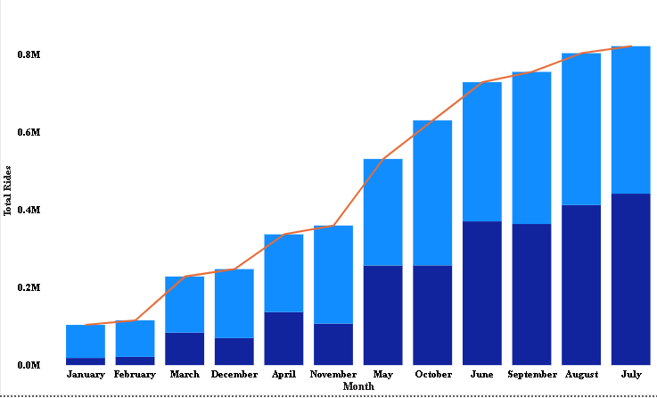
NUMBER OF RIDES PER MONTH AND RIDER TYPE
Looking at this chart, I will like to start that the light blue shade area is that of Member Rider Types, and the deep coloured one, casual Rider Type.
Getting the first point out, the chart shows that, the total rides for members overall was higher than for casual type riders at member types (3127293) and casual type riders (2540693).
Also, from the chart, it shows that a lot of riders participated more in July than any other month by 7.80% of the total.
Total Rides for member and casual diverged the most when the Month was November, when member were 146120 higher than casual.

Slide 9
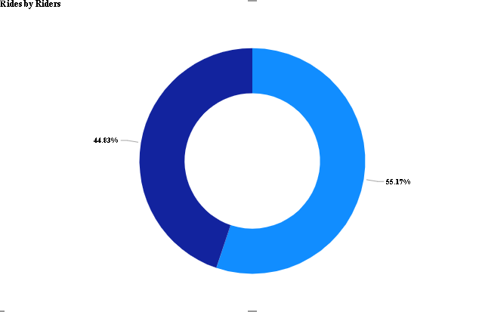
Total rides per rider type
I will like to establish that the member type riders is illustrated us light blue color from the chart whiles the casual type riders are of the deeper blue color.
From this, we can see that, Total Rides for member type riders which is (3127293) was higher than casual type riders which is (2540693).
Member type riders accounted for 55.17% of Total Rides.

Slide 10
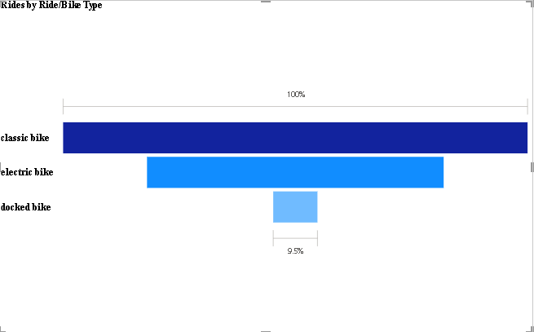
TOTAL NUMBER OF RIDES BY BIKE TYPE
This chart shows that total rides by classic bike type far exceeded the remaining two at 3268797 total rides followed by electric bikes at 2087901 total rides and finally docked bikes at 311288 total rides.

Slide 11
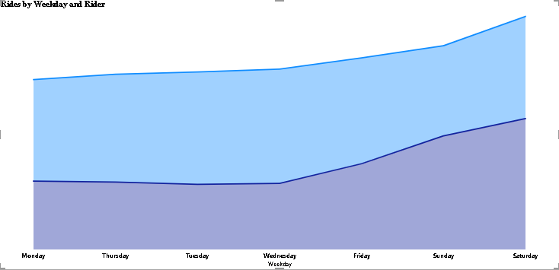
TOTAL RIDES BY WEEKDAY AND RIDER TYPE
Saturday in Rider casual made up 9.83% of Total Rides.
Average Total Rides was higher for member (446,756.14) than casual (362,956.14).
Total Rides for member and casual diverged the most when the Weekday was Wednesday, when member were 206020 higher than casual

Slide 12
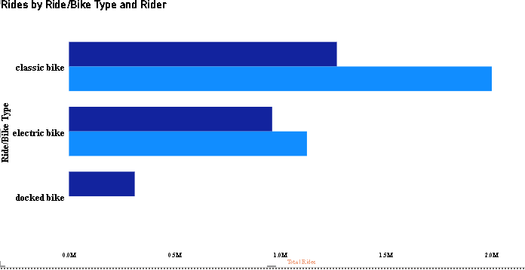
TOTAL RIDE BY BIKE TYPE AND RIDER
classic bike in Rider_member made up 35.30% of Total Rides.
Average Total Rides was higher for member TYPE RIDERS (1,563,646.50) than casual TYPE RIDERS (846,897.67).
Total Rides for member and casual diverged the most when the Ride/Bike Type was classic bike, when member were 733229 higher than casual.

Slide 13
THANK YOU

